Slide 1
SMARTERKOREAN
Korean
Filler
Words
How To Speak Korean Naturally

Slide 2
Can I use filler words even if I am a beginner?
Absolutely!
Filler words will help you sound more natural
Give you time to think while speaking
Will impress Korean speakers
SmarterKorean

Slide 3
Filler Words
그러니까
뭐랄까
그게
있잖아(요)
뭐지
뭐라고 해야되지
SmarterKorean Online Language Classes

Slide 4
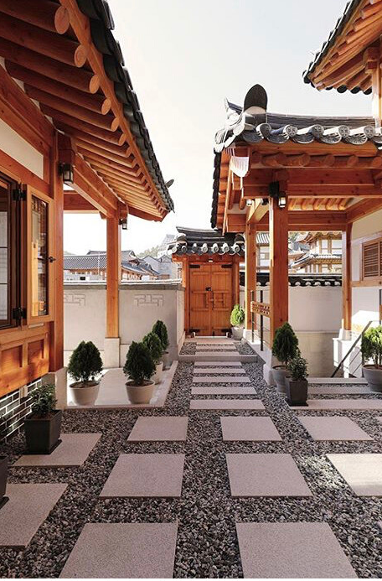
그러니까
So, thats why, therefore
How To Use It:
Typically used at the beginning of a conversation to tell a story.
Also used when agreeing with someone about something
Example:
지민: 우리 언제 만날 거야? 우리 안 본지 너무 오래됐다!
민지: 그러니까...요즘 너무 바빠서 못 만났다. 내일 시간이 있으면 보자!
SmarterKorean

Slide 5
그게
That, well, so the thing is, what happened was...
How To Use It:
Typically used at the beginning of a conversation to tell a story or to explain something.
Can also be used with 그러니까
Example:
지민: 어제 왜 안 왔어요?
민지: 그러니까...그게.. 배가 아파서 못 갔어요.
SmarterKorean

Slide 6
What filler words do you use when speaking in Korean?
SmarterKorean

Slide 7
뭐랄까 (뭐라고 할까)
What should I say...?
How should I put it?
Well...
This is often used when you want to pause before speaking and it lets the listener know that you are thinking.
*Self Talk
Example:
나: 시험 어땠어
가: 음..뭐랄까...그렇게 힘들진 않았어
SmarterKorean

Slide 8
있잖아(요), 그게 있잖아요
You know...
How to use it:
You can use this expression when you want to start talking about something. It lets the listener know that you are about to bring something up or even ask a question. Also can be used when you want to stall before answering a question.
Example:
나: 어디 갔었어요 어제?? 기다리고 있었어요!
다: 그게 있잖아요....어제 급한 일이 생겨서 못 갔어요.

Slide 9
뭐지
What, What is it
How To Use It:
Typically used as self talk when asking yourself a question about something.
Example:
지민: 정답이 뭐야?
민지: 음..뭐지...2번인 것 같아요.
SmarterKorean

Slide 10
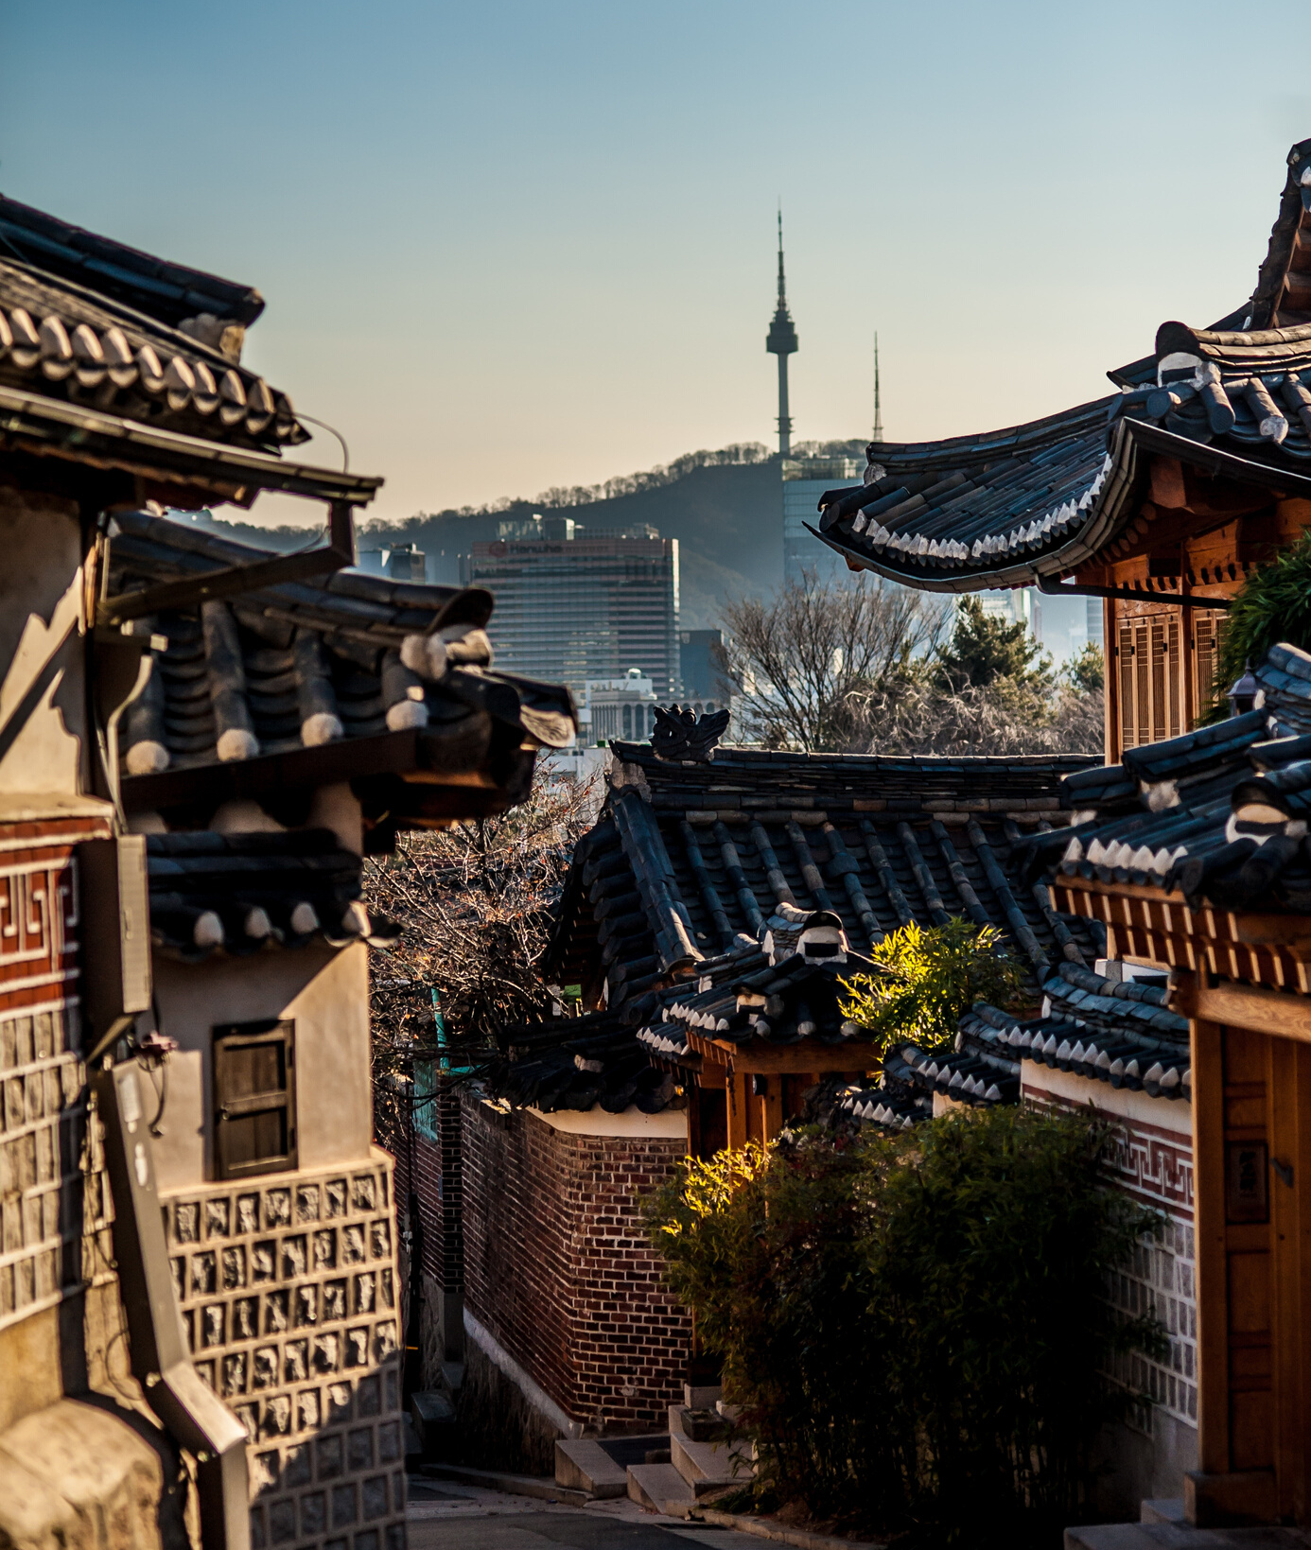
뭐라고 해야되지
What should I say...
How to use it:
A good filler/ staller expression when you want to either try to explain something, think of the name of something, or show you are confused.
Example:
나: 이거 어떻게 해
다: 흠...뭐라고 해야되지...일단...

